Slide 1
SIMULATION OF THE SHAPE OF LEIDENFROST DROPLET
NAME: Ayan Panja
CLASS: BME-III
ROLL: 001811201007
DEPT. OF
MECHANICAL ENGINEERING

Slide 2
INTRODUCTION
The term Leidenfrost droplet refers to the effect called “Leidenfrost effect”. This effect is observed during the boiling of a liquid.
It is a physical phenomenon where a liquid close to a surface whose temperature is significantly higher than the liquid’s boiling point produces a insulated vapor layer which significantly reduces the boiling heat flux from the solid surface.
This effect is named after the German doctor Jonathan Gottlob Leidenfrost, who described it in A Tract about some qualities of Common Water in 1751.
The droplets usually have a Pan cake shape and these’ve a self propelling nature hence used widely in industries as no additional power is required.
In This effect heat flux is minimum. So at this temperature a person can easily dip a wet finger in molten lead, blow out a mouthful of liquid nitrogen without causing any damage.

Slide 3
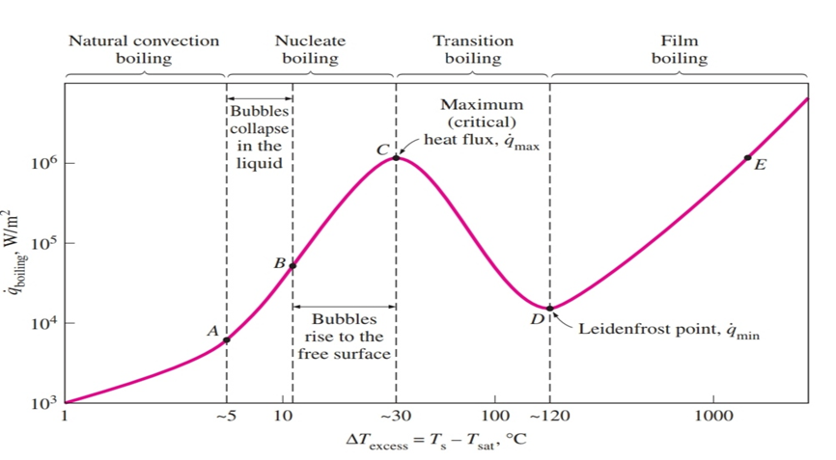
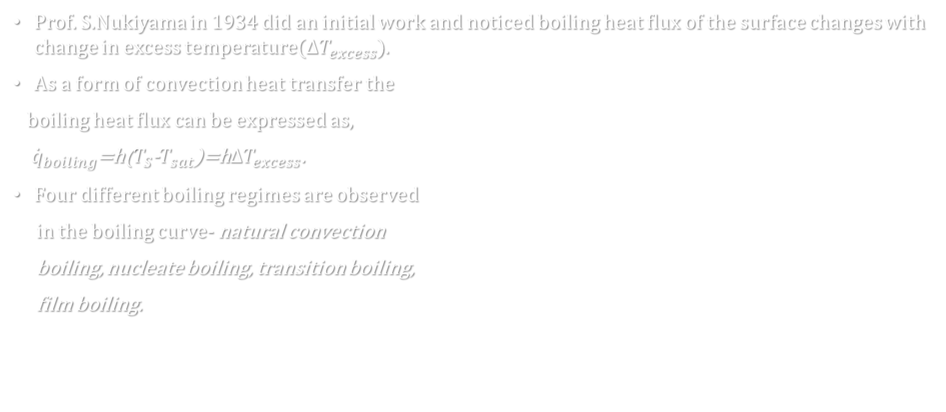
DIFFERENT STAGES OF BOILING
Prof. S.Nukiyama in 1934 did an initial work and noticed boiling heat flux of the surface changes with change in excess temperature($∆T_{excess}$).
As a form of convection heat transfer the
boiling heat flux can be expressed as,
${\dot{q}}_{boiling}$=h($T_{S}$-$T_{sat}$)=h$∆T_{excess}$.
Four different boiling regimes are observed
in the boiling curve- natural convection
boiling, nucleate boiling, transition boiling,
film boiling.

Slide 4
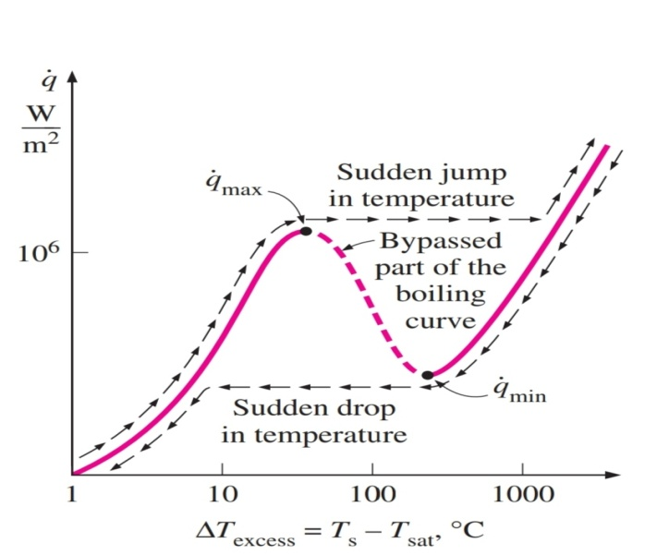

At point D where heat flux reaches the minimum value, is called Leidenfrost point. Here the heater surface is completely covered by a continuous stable vapor film. Vapor being a bad conductor of heat it acts like an insulator.
In case of typical boiling process it won’t follow the curve beyond C. In case of heater having nichrome wire when heat flux exceeds ${\dot{q}}_{max}$burnout occurs.
So platinum wire is used instead as it has higher
melting point.
Here we’ve taken case of approaching LFP from film
boiling region. In gradually reducing power a sudden
drop in $∆T_{excess}$ is observed after point D.
Minimum heat flux at Leidenfrost point, from Zuber’s
equation using stability theory is given by
${\dot{q}}_{min}=0.09ρ_{v}h_{fg}{\left[\frac{σg\left(ρ_{l}−ρ_{v}\right)}{{\left(ρ_{l}+ρ_{v}\right)}^{2}}\right]}^{1/4}$
[$ρ_{v}$, $ρ_{l} , σ$ are density of vapor, liquid, surface tension of
liquid, $h_{fg}$is latent heat of vaporisation]

Slide 5

MATHEMATICAL FORMULATION
We’ve formulated the problem by approaching the LFP from film boiling (higher temp)side.
In spray quenching water is deposited in form of droplets over the hot surface. When surface attains Leidenfrost temperature the droplets attains a specific shape i.e. pancake.
In this model that particular shape is captured along with some assumptions-
Upper surface of the droplet is exposed to constant ambient pressure.
Initial subcooling of the droplet shortly following deposition is ignored.
Any internal circulation within the liquid droplet is neglected.
Any temperature variation within the droplet during the evaporation process is ignored.
The wall, $T_{w}$ is assumed to remain unchanged during the evaporation.
The vapor layer is very thin compared to the droplet size.

Slide 6
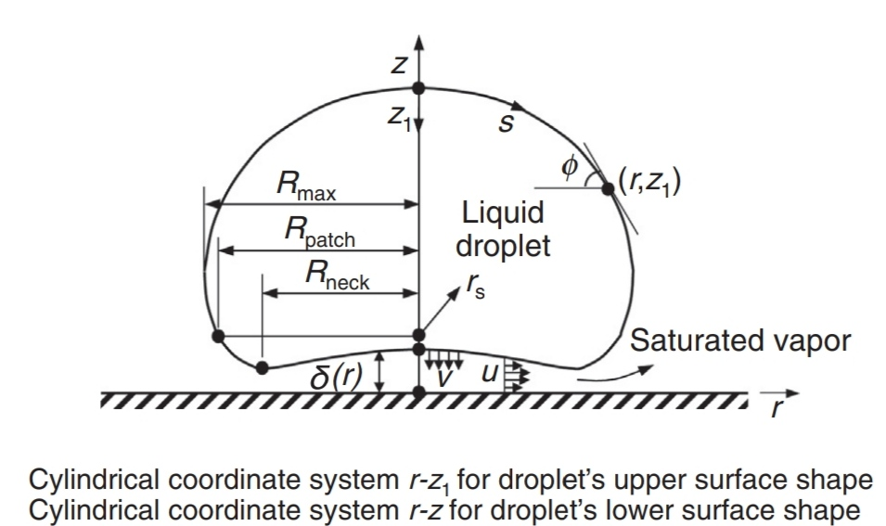


VAPOR flow dynamics
For small thickness the momentum equation of vapor
layer, $\frac{∂P_{g}}{∂r}=μ_{g}\frac{∂^{2}u}{∂Z^{2}}$ ---(1)
Radial velocity at bottom surface is neglected and for
no-slip condition at solid surface u is zero, Hence B.C.
$u\left(Z=0\right)=0$ --(2a) , $u\left(Z=δ\right)=0$ --(2b).
Integrating (1) with B.C.s yields
$u\left(r,Z\right)=\frac{1}{2μ_{g}}\frac{dP_{g}}{dr}(Z^{2}−δZ)$ ----(3)
Pressure in vapor layer, $P_{g}=P_{0}−(ρ_{f}gδ+σκ)$ ---(4)
Vapor velocity W in z direction, from continuity equation
$\frac{1}{r}\frac{∂(ru)}{∂r}+\frac{∂W}{∂Z}=0$ ------(5)
[P₀ is liq pressure, $ρ_{f},g,δ$,k are liq density, gravity, surface tension, surface curvature]

Slide 7


With boundary condition w=0, z=0 eq. (5) can be integrated to yield
$W=−\frac{1}{r}\frac{∂}{∂r}\left[r\frac{dP_{g}}{dr}\frac{Z^{2}}{12μ_{g}}\left(2Z−3δ\right)\right]$ ----(6)
Which combined with eq. (4) simplified to the form
$W=\frac{1}{r}\frac{d}{dr}\left[\frac{Z^{2}}{12μ_{g}}\left(2Z−3δ\right)r\frac{d}{dr}\left(ρ_{f}gδ+σκ\right)\right]$ ---(7)
The vapor production rate per unit area v from the lower droplet interface can be obtained from heat balance
$ρ_{g}vh_{fg}=\frac{k_{g}}{δ}\left(T_{w}−T_{sat}\right)+εσ_{sb}\left(T_{W}^{4}−T_{sat}^{4}\right)$ ----(8)
Mass conservation for z direction vapor velocity w requires that
$W|_{Z=δ}=−v$ ------(9)
By substituting (8),(9) into (7) and introducing capillary length
$l={\left(σ/{ρ_{f}g}\right)}^{1/2}$ ------(10)
The following equation is obtained for dimensionless vapor layer thickness:
$\frac{d}{dr^{∗}}\left[r^{∗}δ^{∗3}\frac{d}{dr^{∗}}\left(κ^{∗}+δ^{∗}\right)\right]−\frac{12χr^{∗}}{δ^{∗}}=0$ ----(11)
[$h_{fg}$,$k_{g},ε,σ_{sb}$ being the latent heat of vaporisation, vapor conductivity, emissivity and Stefan-Boltzman constant respectively.]

Slide 8


Here parameters with asterisk are nondimensionalized forms. Non dimensionalization is done w.r.t. capillary length viz. $r^{∗}$=$r/l$, $δ^{∗}$= δ/l, $κ^{∗}$=kl.
Parameter $χ$ is a dimensionless parameter accounting for fluid properties and surface heating,
$χ=\frac{μ_{g}\left[k_{g}\left(T_{W}−T_{sat}\right)+εσ_{sb}lδ^{∗}\left(T_{W}^{4}−T_{sat}^{4}\right)\right]}{ρ_{g}σlh_{fg}}$ ----(12)
DROPLET SHAPE ANALYSIS:
As illustrated in the figure the surface of a sessile droplet can be divided into
two parts along the perimeter of the circle of radius $R_{patch}$. The analysis of upper and lower part is given by-
Upper droplet surface:
The shape of the upper droplet surface is governed by a balance between hydrostatic pressure and capillary pressure.
$σκ−ρ_{f}gz_{1}=σκ_{0}$ ----(13) where k₀ is surface curvature at r=0 and z₁ is measured from droplet apex.
By introducing capillary length eq. (13) can be nondimensionalized to the form-
$κ^{∗}=z_{1}^{∗}+κ_{0}^{∗}$ ---(14)

Slide 9

An angle $φ$ is introduced which is angle between tangent of arc and horizontal line.
Eq. (14) is solved in terms of arc length s along the droplet surface. It can be transformed into
$\frac{dφ}{dS^{∗}}=z_{1}^{∗}+κ_{0}^{∗}$ --------(15a)
$\frac{dr^{∗}}{dS^{∗}}=\cos{φ}$ ---------(15b)
$\frac{dZ_{1}^{∗}}{dS^{∗}}=\sin{φ}$ -------(15c)
Which are subjected to boundary conditions
$φ(0$) = 0 ----(16a)
$r^{∗}\left(0\right)=0$ ----(16b)
$z_{1}^{∗}\left(0\right)=0$ ----(16c)
All the length parameters are nondimensionalized relative to capillary length. The three first order ordinary differential equations can be easily solved by fourth order Runge-Kutta method from the droplet apex to the patching point.

Slide 10
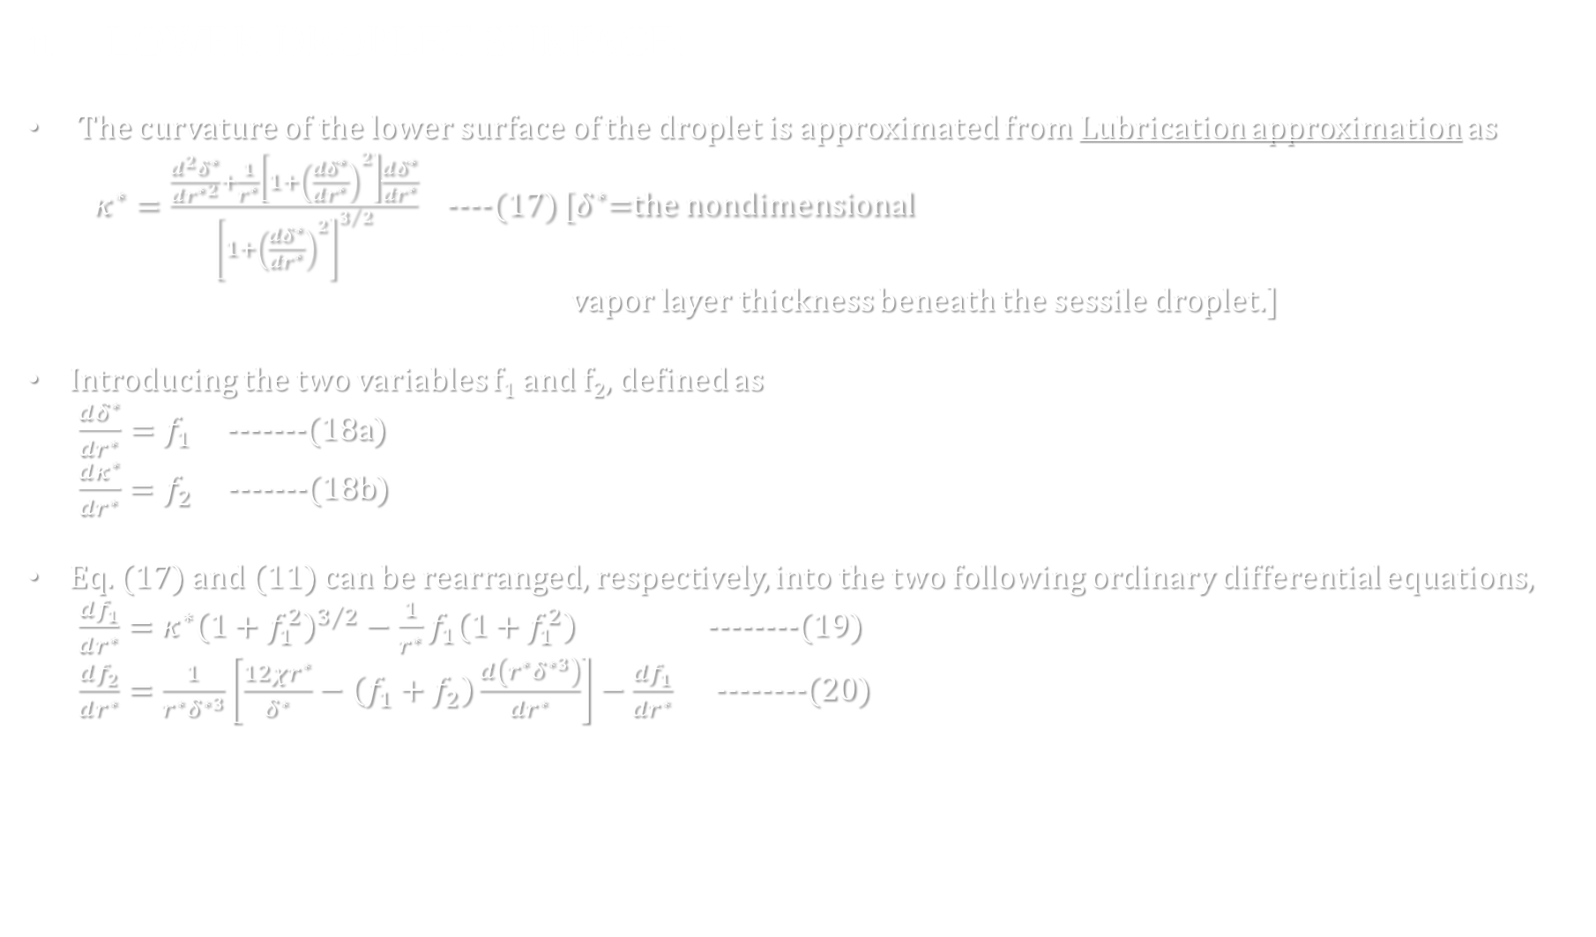
ii. LOWER DROPLET SURFACE:
The curvature of the lower surface of the droplet is approximated from Lubrication approximation as
$κ^{∗}=\frac{\frac{d^{2}δ^{∗}}{dr^{∗2}}+\frac{1}{r^{∗}}\left[1+{\left(\frac{dδ^{∗}}{dr^{∗}}\right)}^{2}\right]\frac{dδ^{∗}}{dr^{∗}}}{{\left[1+{\left(\frac{dδ^{∗}}{dr^{∗}}\right)}^{2}\right]}^{3/2}}$ ----(17) [$δ^{∗}$=the nondimensional
vapor layer thickness beneath the sessile droplet.]
Introducing the two variables f₁ and f₂, defined as
$\frac{dδ^{∗}}{dr^{∗}}=f_{1}$ -------(18a)
$\frac{dκ^{∗}}{dr^{∗}}=f_{2}$ -------(18b)
Eq. (17) and (11) can be rearranged, respectively, into the two following ordinary differential equations,
$\frac{df_{1}}{dr^{∗}}=κ^{∗}{\left(1+f_{1}^{2}\right)}^{3/2}−\frac{1}{r^{∗}}f_{1}\left(1+f_{1}^{2}\right)$ --------(19)
$\frac{df_{2}}{dr^{∗}}=\frac{1}{r^{∗}δ^{∗3}}\left[\frac{12χr^{∗}}{δ^{∗}}−\left(f_{1}+f_{2}\right)\frac{d\left(r^{∗}δ^{∗3}\right)}{dr^{∗}}\right]−\frac{df_{1}}{dr^{∗}}$ --------(20)

Slide 11

To ensure a continuous droplet shape the position, slope, curvature should match that of the upper at the patching point and the curve should be continuous. Therefore the boundary conditions for eqs. (17)-(20) are
a) $f_{1}\left(r=0\right)=0, f_{2}\left(r=0\right)=0$ (due to zero slope and curvature from symmetry),
b) At r=$R_{patch}$ $f_{1}$and k must match corresponding values obtained from the upper surface solution
Eqs. (17)-(20) along with the boundary conditions are solved by the Runge-Kutta and shooting methods.

Slide 12
simulation
In case of the upper curve there are three simultaneous O.D.E. [eqs (15a),(15b),(15c)] which along with the boundary conditions [eqs (16a),(16b),(16c)] constitutes a typical boundary value problem.
It’s solved by fourth order Runge-Kutta method using a matlab code and the r vs z curve is further plotted by matlab.

Slide 13

Pseudo code
for i =1:length(s*)-1
j0=(z(i))+$κ_{0}^{∗}$;
k0= $cos$($φ$(i));
l0= $sin$($φ$(i));
j1=(z(i)+0.5*h*l0)+$κ_{0}^{∗}$;
k1= $cos$($φ$(i)+0.5*h*j0);
l1= $sin$($φ$(i)+0.5*h*j0);
j2=(z(i)+0.5*h*l1)+$κ_{0}^{∗}$;
k2= $cos$($φ$(i)+0.5*h*j1);
l2= $sin$($φ$(i)+0.5*h*j1);
j3=(z(i)+h*l2)+$κ_{0}^{∗}$;
k3= $cos$($φ$(i)+h*j2);
l3= $sin$($φ$(i)+h*j2);
$φ$(i+1)= $φ$(i)+(h/6)*(j0+2*j1+2*j2+j3);
r(i+1)=r(i)+(h/6)*(k0+2*k1+2*k2+k3);
z(i+1)=z(i)+(h/6)*(l0+2*l1+2*l2+l3);

Slide 14
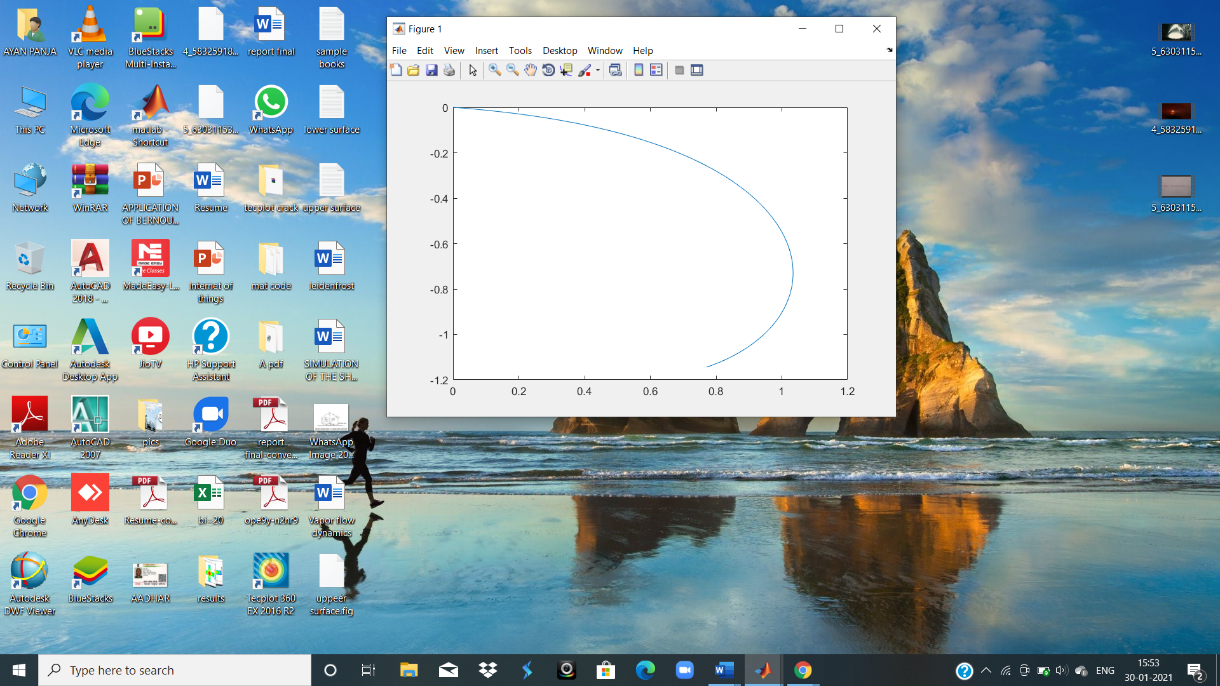

plotting
Here we’ve plotted the curve between r & z after solving the equation for
$κ_{0}^{∗}$=0.2.

Slide 15
Submission of code
clc
clear all
h=0.001; %initializing step size
s=0:h:2; %initializing domain of independent variable s
n=length(s);
q=zeros(1,n); %angle of tangent of arc with horizontal line
r=zeros(1,n); %radius of droplet
z=zeros(1,n); %height of droplet
k=input('enter value of curvature at apex : ');
F=@(z)(z+k);
G=@(q)(cos(q));
H=@(q)(sin(q));

Slide 16
for i=1:n-1 %implementing RK-4 method
j0=F(z(i));
k0=G(q(i));
l0=H(q(i));
j1=F(z(i)+0.5*h*l0);
k1=G(q(i)+0.5*h*j0);
l1=H(q(i)+0.5*h*j0);
j2=F(z(i)+0.5*h*l1);
k2=G(q(i)+0.5*h*j1);
l2=H(q(i)+0.5*h*j1);
j3=F(z(i)+h*l2);
k3=G(q(i)+h*j2);
l3=H(q(i)+h*j2);
s(i+1)=s(i)+h;
q(i+1)=q(i)+(h/6)*(j0+2*j1+2*j2+j3);
r(i+1)=r(i)+(h/6)*(k0+2*k1+2*k2+k3);
z(i+1)=z(i)+(h/6)*(l0+2*l1+2*l2+l3);
end
plot(r,-z)

